Slide 1
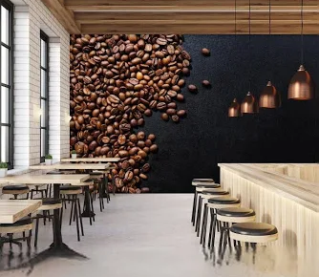
BRIGHT COFFEE SHOP | SHOPPING TRENDS
Andile Ngcongwane | DATA ANALYTICS

Slide 2
Total number of sales over 6 months: 149116
The shop sales have been consistently making higher sales over the period of 6 months, evidently sales grow as seasons approach winter

Slide 3
Revenue per day of the week for each shop
Data in this chart specifies the top performing shop per day of the week
Hell’s Kitchen generate the most revenue on Tuesdays and Fridays than all the shops
Lower Manhattan takes the number 2 spot for revenue it generates on Mondays, but is closely followed by Astoria on the same day
However, on Wednesdays and Thursdays Astoria keeps their revenue higher than all the shops
Fridays is Hell’s Kitchen day due to their high revenue they suddenly gain beating all 3 shops by a mile

Slide 4
Number of Sales (Weekday/Weekend)
The establishment makes better sales during the week than it does on the weekends, perhaps this is caused by the customers seeing the establishment as an ideal place to fill the rush before business day begins

Slide 5
Revenue per time of day (Morning, Afternoon and Evening)
Sales reflect that every morning at all stores customers buy more as compared to the afternoons and evenings which simply means the products are good for mornings consumption.

Slide 6
Revenue per season
The store makes the most sales in winter, the season before which is autumn the sales reflect a rally in trend indicating that the products are ideal for a cold weather. If we look back at the previous data of time of day, the mornings make better sales than afternoons and evenings which still indicates the same point of the products being ideal for the cold weather.

Slide 7
Transaction QTY per product category
The sales from the perspective of product categories clarifies why we see sales performing better during the winter mornings, and that is because hot products like coffee and tea, and the bakery are most loved in this establishment, better than just buying coffee beans and some flavours.

Slide 8
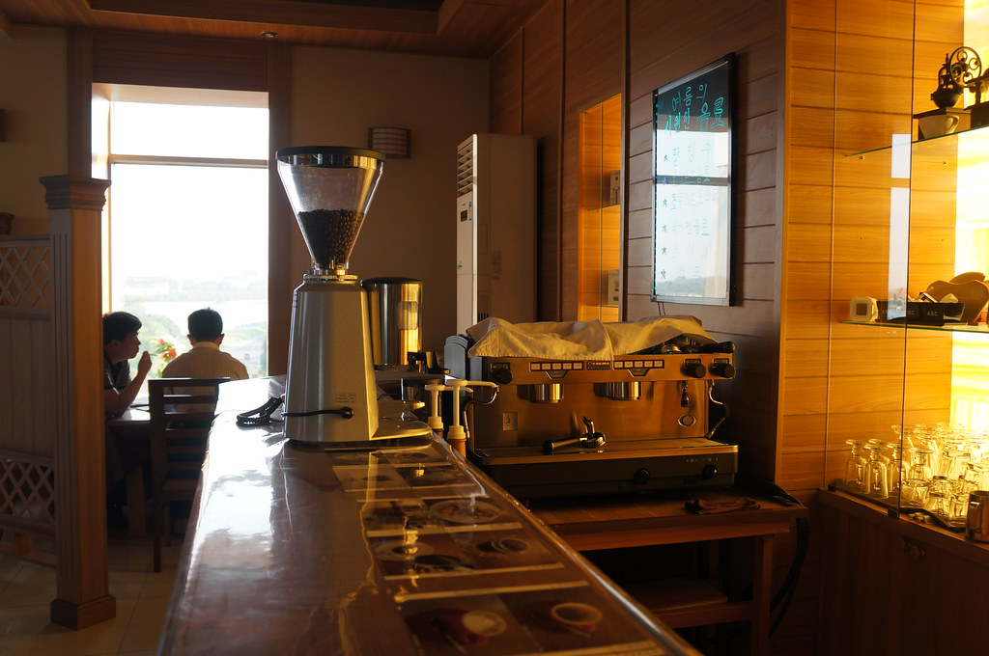
DISCOVERY
&
RECOMMENDATIONS
Mix flavours with coffees and with teas to boost sales of flavours and promote such combo’s on days that make less revenue according to collected and analysed data.
Have campaign days on weekends and have coffee beans and packaged chocolates as promotion packs and target especially kids, this is due to low weekend sales.
Make Freezo’s, slush drinks, Iced coffees and iced teas to boost summer sales and evening sales.
In addition to boosting summer sales, the shop could have picnic themes in summer to boost special campaigns.
This Photo by Unknown Author is licensed under CC BY-SA

